Slide 1
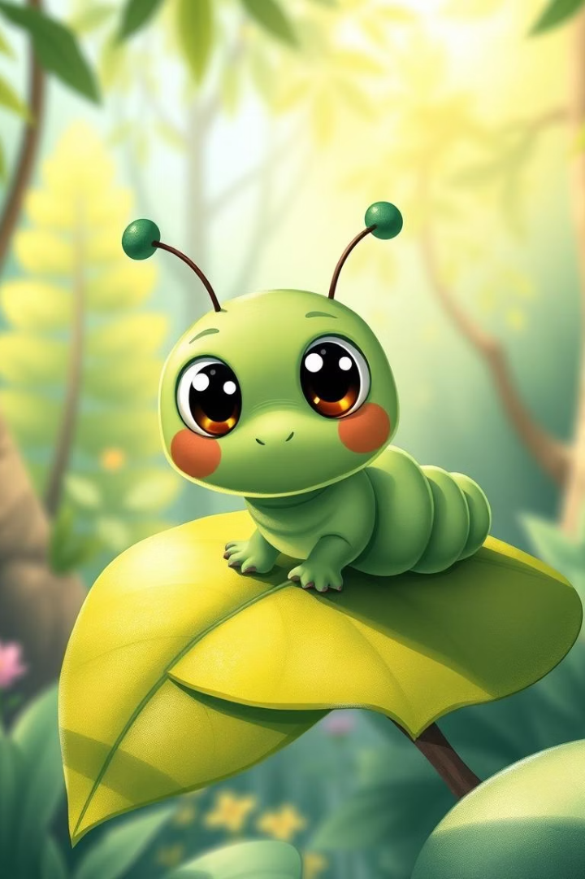



Discovering "A Caterpillar Called Matthew"
Embark on a delightful journey into Deepa Agarwal's heartwarming story. Celebrate the magic of self-discovery and friendship. Perfect for Grade 6 readers seeking adventure and life lessons.
by Praveena Ramesh

Slide 2




About Deepa Agarwal
Acclaimed Indian Author
Relatable Characters
She creates engaging narratives with familiar characters.
Deepa Agarwal is known for children's literature.
Award-Winning Storyteller
Her focus often highlights rich cultural themes.

Slide 3





Matthew's Transformative Journey
Quest for Identity
Matthew seeks purpose and self-discovery.
Befriending Forest Creatures
He connects with birds, squirrels, and more.
Overcoming Obstacles
Matthew embraces his unique individuality.
Finding Simple Joy
He discovers beauty in nature's wonders.

Slide 4
Themes of Friendship and Identity
Significance of Companionship
Embracing Uniqueness
Importance of Self-Acceptance
Self-Discovery
Finding true belonging in the world.
Exploring the meaning of support and camaraderie.
Celebrating personal growth and individuality.
Understanding one's worth and place.

Slide 5
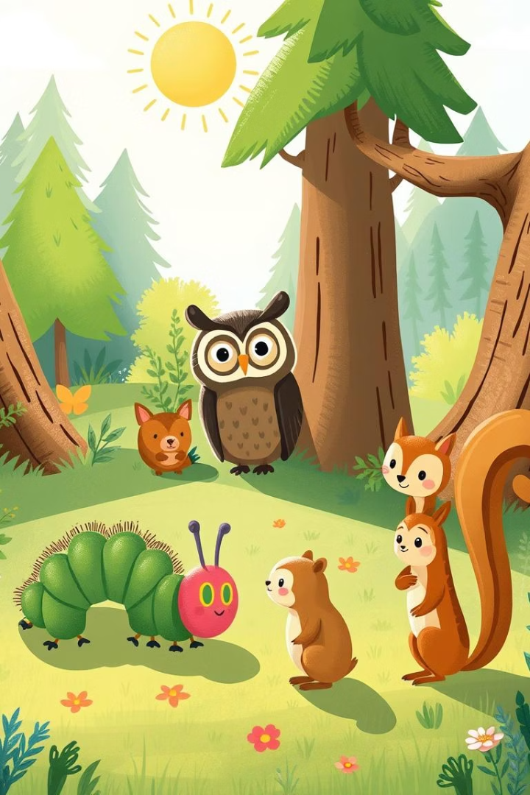
Memorable Characters
Matthew
The adventurous, curious caterpillar.
Diverse Animal Friends
Offering guidance and camaraderie.
Dynamic Interactions
Showcasing empathy and understanding.
Character Development
From questioning to self-assured.

Slide 6





Agarwal's Captivating Writing Style
Vivid Descriptions
Profound Language
Skillful Metaphors
Encouraging Imagination
Bringing the forest to life.
Engaging young readers with simple words.
Conveying deeper meanings effortlessly.
Promoting reflective thinking in readers.

Slide 7








Classroom Activities and Discussions
Creative Writing
Art Projects
Prompts inspired by Matthew's adventures.
Illustrating favorite scenes or characters.
Role-Playing
Group Discussions
Acting out dialogues and interactions.
Exploring themes of friendship and identity.

Slide 8
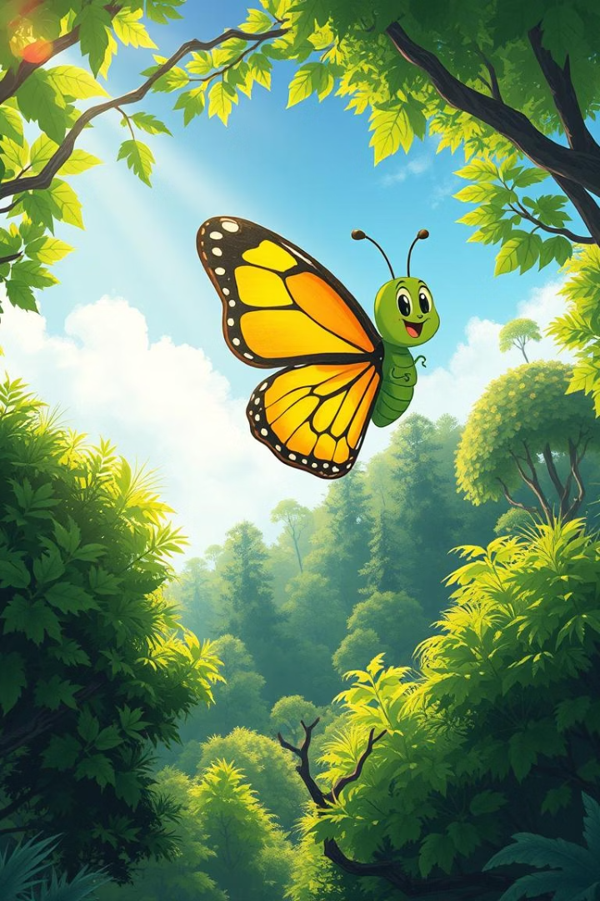
Conclusion
Timeless Tale
"A Caterpillar Called Matthew" offers a journey of self-discovery.
Embrace Individuality
The story encourages young readers to be themselves.
Celebrate Nature
It highlights friendship and the beauty of the natural world.
Must-Read for Grade 6
Seek inspiration and joy in this captivating story.

